Slide 1
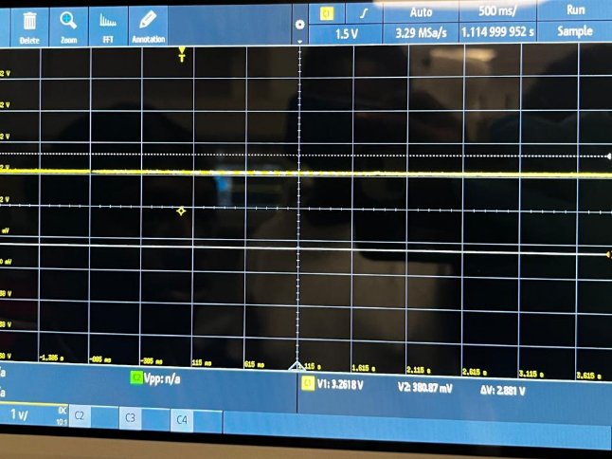
Oscilloscope Verification of PWM on Raspberry Pi
By :- Bilal Hussain & Nikunj Patel

Slide 2
Objective
The main purpose of this assignment is to test the PWM functionality on the RPi in the lab with the oscilloscope.
Testing the duty cycle at 75% and 90%.

Slide 3
PWM Testing
Used GPIO18 (Pin 12) for PWM output
Tested duty cycle at 75% and 90%
Verified waveforms on oscilloscope
LED provided visual confirmation of brightness change

Slide 4
Keyboard Inputs
a → LED on time 25%.
s → LED on time 50%.
d → LED on time 75%.
w → LED on time 90%.

Slide 5
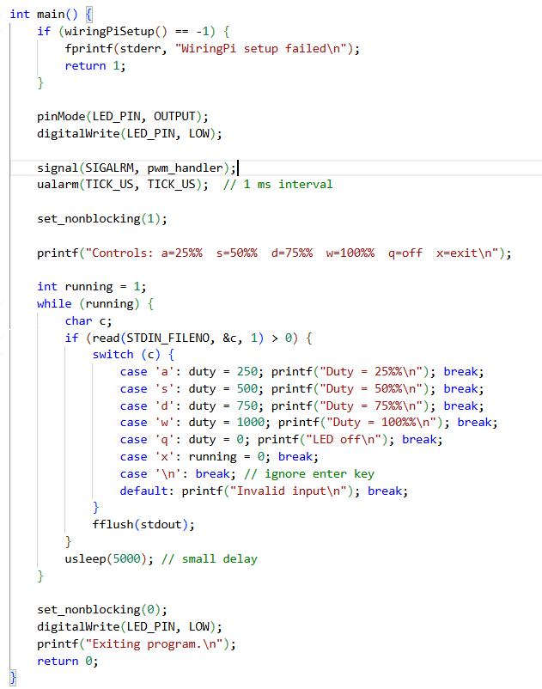
Code

Slide 6
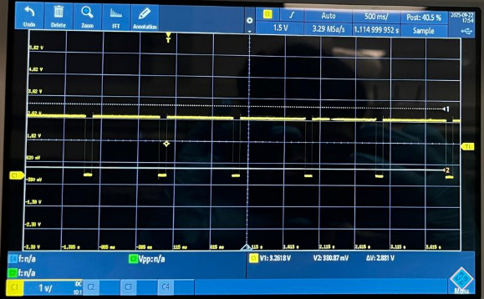
Oscilloscope readings at 90%

Slide 7
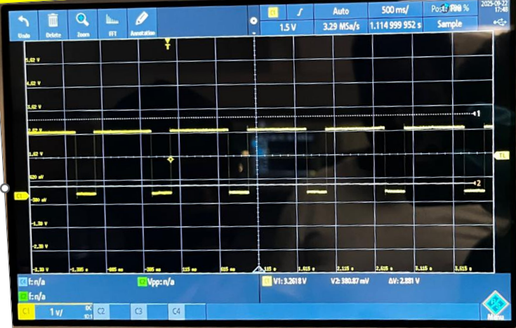
Oscilloscope readings at 75%

Slide 8

Results
PWM signals observed at 75% and 90% duty cycles
Oscilloscope confirmed correct waveforms
LED brightness matched duty cycle

Slide 9
Conclusion
Demonstrated PWM generation on Raspberry Pi
Verified with oscilloscope
Controlled motor using L293D with PWM speed and GPIO direction
Learned about PWM duty cycle, frequency, and safe GPIO usage

Slide 10
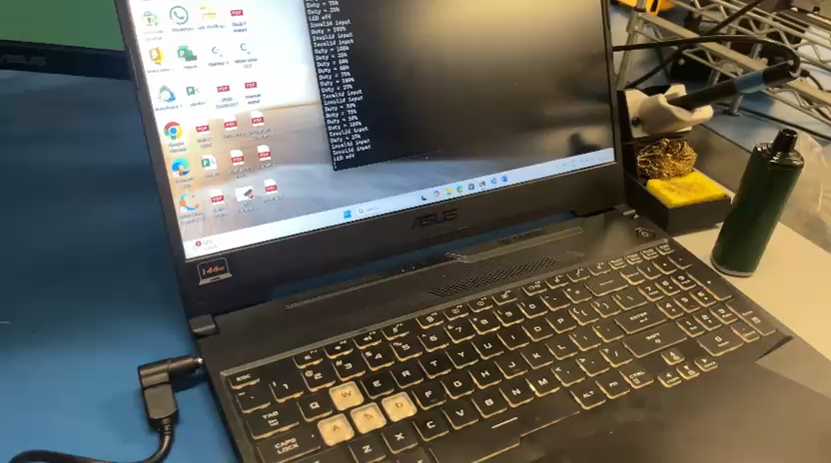
Testing Video

